Slide 1
INTELLIGENT INFORMATION ACCESS AND NATURAL LANGUAGE PROCESSING
Emotional City
Professors:
Giovanni SEMERARO
Pierluigi CASSOTTI
Student:
Davide DI PIERRO

Slide 2
WHAT IS EMOTIONAL CITY
Emotional City is an integrated platform that, through public sources (newspapers, social platforms, opendata, etc.) carries out an NLP pipeline that involves sentiment analysis process and lexical semantic change detection.
The goal is to collect all the tweets written in Apulia, and concerning Apulia, of the last eighteen months. From these tweets, it will then be necessary to perform sentiment analysis to collect statistics on topics related to our region. For the collection and some preliminary analysis, Crowd Pulse can help us as it is able to retrieve data from Twitter by filtering them by keywords, users or geolocation. It also has plugins that allow some preliminary operations such as tokenization, stopword removal, lemmatization and sentiment analysis with SentIt.

Slide 3
PIPELINE
01
02
03
DATA EXTRACTION
API IMPLEMENTATION
RETRIEVE DATA
Extraction of tweets from Twitter
Python application for looking for data
Emotional City for retrieving data

Slide 4
Twitter APIs
{
"data": {
"id": "2244994945",
"name": "Twitter Dev",
"username": "TwitterDev"
}
}
All Twitter APIs that return Tweets provide that data encoded using JavaScript Object Notation (JSON). JSON is based on key-value pairs, with named attributes and associated values. These attributes, and their state are used to describe objects.

Slide 5



FILTER TWEETS
NAME
TRACK
LOCATIONS
LANGUAGE
Tweets of specific persons
Keywords to track
Specifies a set of bounding boxes to track
Tweets detected as being written in the specified languages

Slide 6
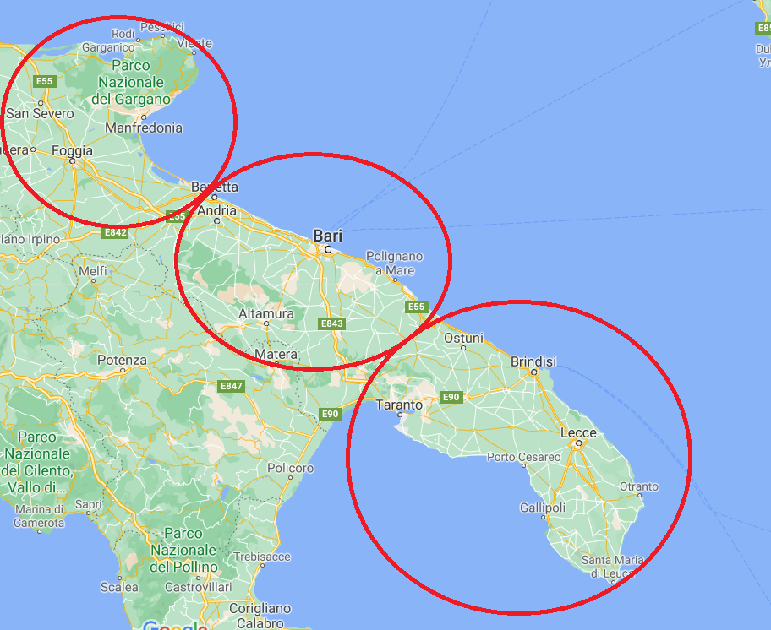

LOCATIONS
point_radius
bounding_box
centre
min longitude
radius
min latitude
max longitude
max latitude

Slide 7

DESIGN AND IMPLEMENTATION
Crowd Pulse and Application

Slide 8
CROWD PULSE

Slide 9
CROWD PULSE
Crowd Pulse is a platform for the semantic analysys of social contents. It allows to extract, filter, manipulate and analyze data retrieved from social (Twitter in our case). We can perform all these operations by means of a configuration file written in JSON inside the Crowd Pulse platform. Each configuration file is called project. Each project is composed by:
Process: it contains information about the name of the project and logs’ path;
Nodes: it contains plugins and the configurations of them;
Edges: describe the sequence in which plugins activate;
The core of Crowd Pulse are the available plugins.

Slide 10
AVAILABLE PLUGINS
email-notify social-twitter
social-facebook data-java
detect-language-optimaize geo-profile-google-maps
geo-message-from-profile index-uniba
tag-babelfy tag-me
tag-open-calais tag-wikipedia-miner
categorize-wikipedia tokenize-open-nlp
lemmatize-morphit lemmatize-stanford-corenlp
lemmatize-multi pos-tag-open-nlp
pos-tag-simple-it pos-tag-simple-en
pos-tag-simple-multi rem-stop-word-simple
infogram sentiment-sentit
sentiment-sentiwordnet

Slide 11
AVAILABLE PLUGINS
email-notify social-twitter
social-facebook data-java
detect-language-optimaize geo-profile-google-maps
geo-message-from-profile index-uniba
tag-babelfy tag-me
tag-open-calais tag-wikipedia-miner
categorize-wikipedia tokenize-open-nlp
lemmatize-morphit lemmatize-stanford-corenlp
lemmatize-multi pos-tag-open-nlp
pos-tag-simple-it pos-tag-simple-en
pos-tag-simple-multi rem-stop-word-simple
infogram sentiment-sentit
sentiment-sentiwordnet

Slide 12
social-twitter
This plugin will be used to retrieve tweets. There are different filters available:
Based on content (terms, hashtag, etc.);
Based on user (sent and received);
Based on geo-coordinates(bounding_box approach);
Based on filters (language, date, etc.);
Combination of filters;
The plugin is named "extractor-twitter“. This is the extractor we will use for Emotional City:
{ "process": { …},
"nodes": {
"message-extractor": {
"plugin": "extractor-twitter",
"config": {
"query": [
"puglia",
…
],
“location”: "14.7748476736", "39.6176788304", "19.0160785326", "42.2822860976",
"since": "2019-07-01",
"language": "it"
}
},
"message-persister": { …}
},
"edges": { … } }

Slide 13
data-java
For storing the data, the message-persist plugin must be used. The only parameter in the configuration is the name of the database on which data will be stored. This plugin is already present in the previous slide:
"message-persister": {
"plugin": "message-persist",
"config": {
"db": "emotionalcity"
}
}
At the end of the extraction and saving, we can see the amount of data collected per time period through Crowd Pulse. This is an example of data collected only in one day (just for example).

Slide 14
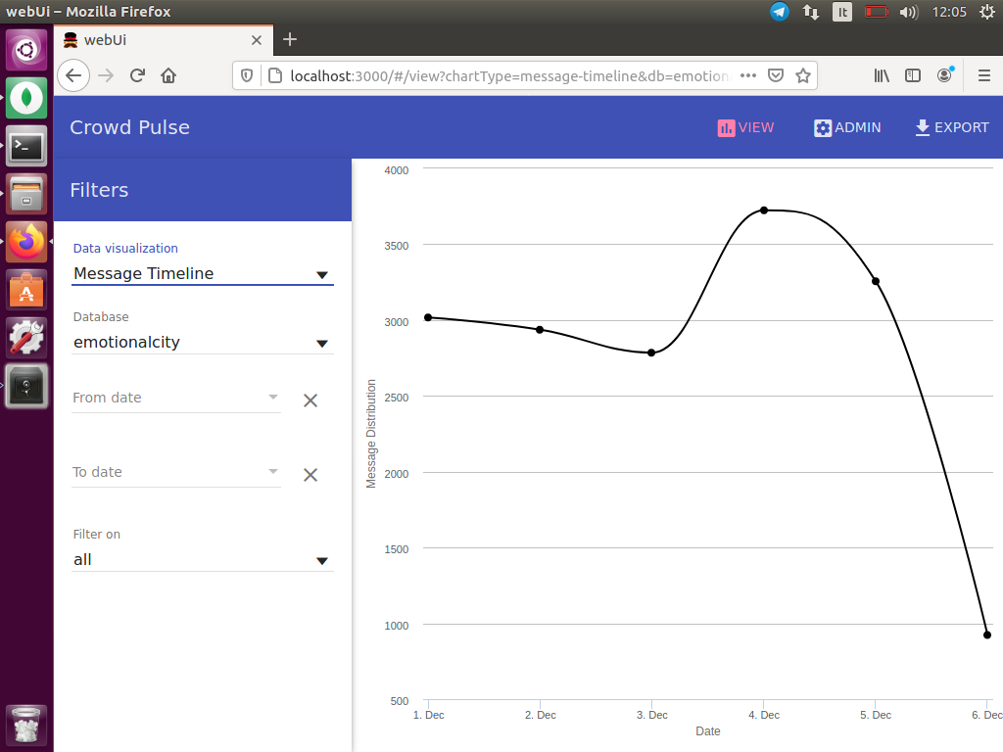
Message Timeline

Slide 15
tokenize-opennlp
This plugin for tokenizing data previously retrieved. In its configuration we can specify the minimum number of characters a word must contain to be considered useful and if we want to consider mentions, urls or hashtags. In our case, first we retrieve data from the database emotionalcity, then we tokenize the tweets and finally we store the new data in the same database.
{
"process": { … },
"nodes": {
"fetch": { … },
"tokenizer": {
"plugin": "tokenizer-opennlp",
"config": {
"minChars": "4",
"mentions": "true",
"urls": "true",
"hashtags": "false",
"calculate": "new"
}
},
"persistance": { … }
},
"edges": { … }
}

Slide 16
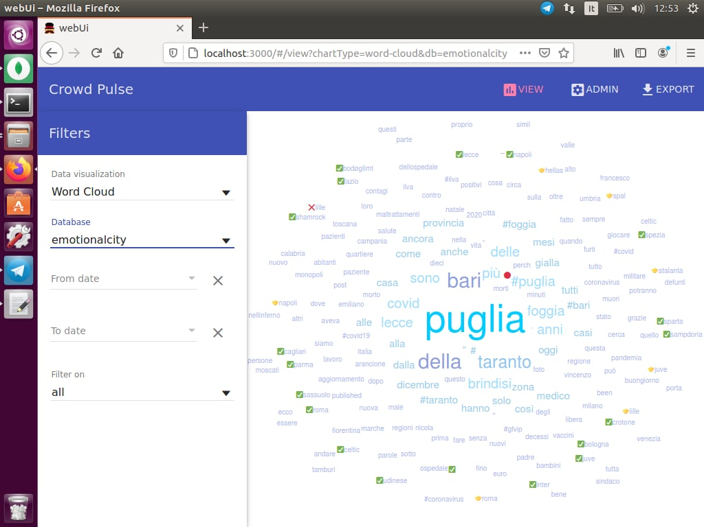
Word Cloud

Slide 17
sentiment-sentit
This plugin provides the sentiment analysis of the tweets. Sentiment analysis algorithms associate a polarity (negative, neutral, positive) to each tweet.
It performs a Machine Learning algorithm called SentIt that returns the polarity of tweets (1: positive, 0:neutral, -1:negative). This is preferred to the approach with SentiWordNet and MultiWordNet because it has been realized from the University of Bari (in particular by professors Novielli and Basile) and so we can have access without limits. Moreover, this system has been oriented to analyze data coming from social networks and does not provide a value for each category (positive, negative, obj) but we have a clear distinction among classes. In this way we are able to calculate statistics in an easier way. The plugin does not require any parameters.
"sentiment": {
"plugin": "sentiment-sentit",
"config": {
"calculate": "new"
}
}

Slide 18
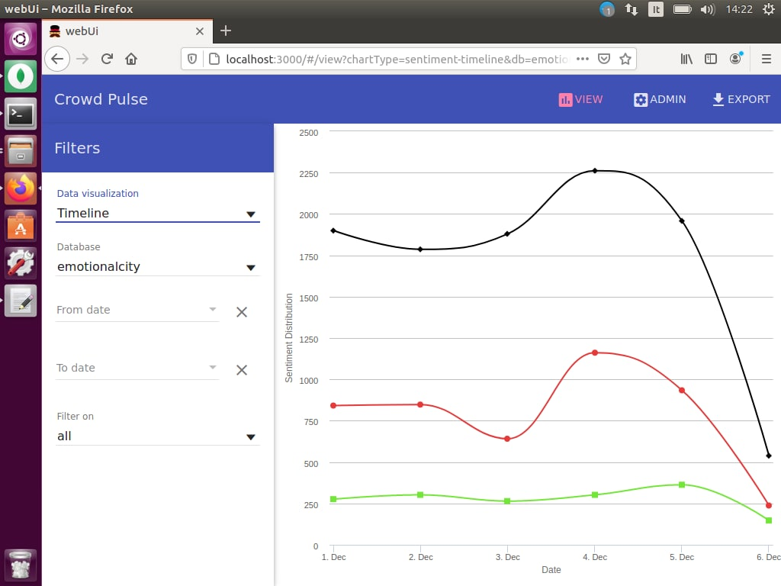
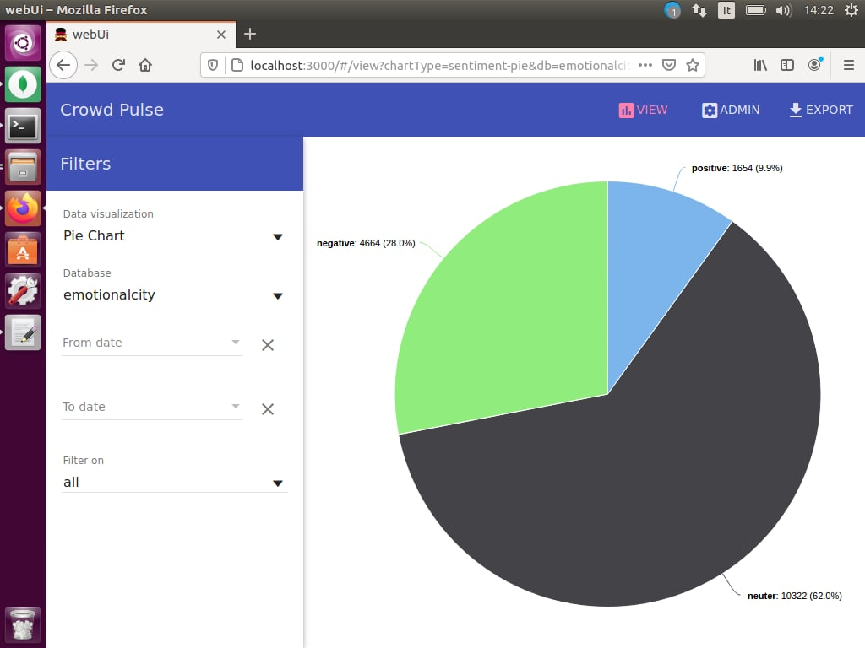
Timeline and Pie Chart

Slide 19

APPLICATION

Slide 20
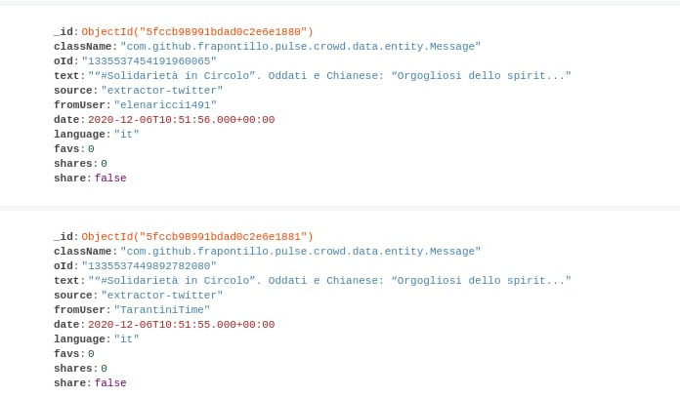
Database
MongoDB is a non-relational, document-oriented DBMS. Classified as a NoSQL type database, MongoDB moves away from the traditional table-based structure of relational databases in favor of JSON-style documents with dynamic schema.
MongoDB is originally conceived as a distributed database; the high availability, horizontal scalability and geographical distribution are therefore native and easy to use. It is also free.
For seeing the data in the db we can use the tool Compass. Let’s have a look on some example data:

Slide 21
Emotional City API
Now that we have a database of tweets, we can start writing the Emotional City functions that will allow us to extract relevant information about Apulia.
The files have been stored in the Google Drive folder of Pierluigi Cassotti, the supervisor of the case study. I used a python source code (called “onedrive.py”) to get the links to retrieve the dump of the database and the metadata. The dump is named “Message.bson” and contains the actual data while “Message.metadata.json” contains the metadata associated to Message (i.e. indexes).
After uploading the data into my MongoDB system, I was able to implement functions to retrieve the useful data. All these functions will be integrated next into a system able to provides API to the Emotional City system. The name of the file collecting these functions is “twitter_requests.py”.

Slide 22
Class Tweet
First, we need to create a class Tweet in order to return information about a tweet in a structured way, when necessary. The class has been specified simply through getters and setters of its elements and the function str which permits to print in a structured way a specific instance.
class Tweet:
def __init__(self, _id, text, fromUser, date, sentiment):
self._id = _id
self.text = text
self.fromUser = fromUser
self.date = date
self.sentiment = sentiment
…
def __str__(self):
return "_id : " + str(self._id) + ", text : " + str(self.text) + ", sentiment : " + str(self.sentiment)

Slide 23
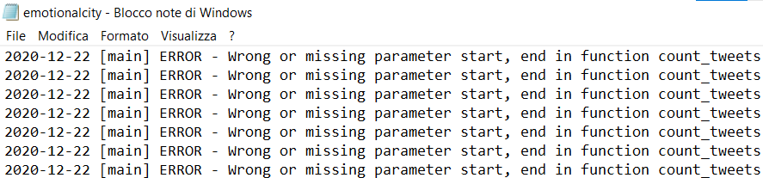
writeLogs
This function is responsible to write logs in order to tracks all the errors encountered in computations. A log file is created and has the same structure of the log generated by Crowd Pulse, so that we can read both logs using the same function.

Slide 24
createTweet
This function creates a new tweet instance using the constructor of Tweet. It is responsible that the mandatory fields are present.
def createTweet(tweet, logger):
…
_id = tweet['_id']
text = tweet['text']
fromUser = tweet['fromUser']
date = tweet['date']
sentiment = tweet['sentiment']
newTweet = Tweet(_id, text, fromUser, date, sentiment)
if("classname" in tweet):
newTweet.setClassName(tweet['className'])
if("oId" in tweet):
newTweet.setOId(tweet['oId'])
if("createdDate" in tweet):
newTweet.setCreatedDate(tweet['createdDate'])
if("source" in tweet):
newTweet.setSource(tweet['source'])
if("toUsers" in tweet):
newTweet.setToUsers(tweet['toUsers'])
if("language" in tweet):
newTweet.setLanguage(tweet['language'])
if("location" in tweet):
newTweet.setLocation(tweet['location’])
…
return newTweet

Slide 25
count_tweets
This function divides the tweets in periods given start, end and time_range. The latter is the dimension of every split. For each period the number of tweets is given. If the parameter only_geo is true, only geo located tweets will be taken into account.
def count_tweets(db, start, end, time_range, only_geo, logger):
…
if(only_geo == True):
tweets = list(db.Message.find({"$and": [ {"date": { "$gte": int2time(start), "$lt": int2time(end) }},
{"location": {"$exists": True} } #geo filter
]}))
else:
tweets = list(db.Message.find({"date": {"$gte": int2time(start), "$lt": int2time(end) }} ))
n_ranges = math.ceil((end-start)/time_range) # no of ranges
ranges = np.zeros((n_ranges, 3))
lower = start;
upper = start + time_range
sum = 0
for i in range (0, n_ranges):
ranges[i][0] = lower
ranges[i][1] = upper
lower = upper
upper += time_range
for i in range(0, len(tweets)):
ranges[int((time2int(tweets[i]['date'])-start)/time_range)][2] += 1
sum += 1
return (ranges, sum)

Slide 26
count_tweets_time
This function has the same goal as count_tweets but accepts start and end as timestamps and not as integers.
def count_tweets_time(db, start, end, time_range, only_geo, logger):
…
return count_tweets(db, time2int(start), time2int(end), time_range, only_geo, logger)

Slide 27
time2int, int2time and string2time
time2int returns the number of seconds passed from the 1970/01/01 until the time passed in input.
def time2int(timestamp):
return int(time.mktime(timestamp.timetuple()))
int2time is inverse to the previous one. It returns the timestamp given the time passed in seconds.
def int2time(seconds):
return datetime.fromtimestamp(seconds)
string2time is the same as time2int but accepts the date in input as string.
def string2int(date):
return int(time.mktime(datetime.strptime(date, "%Y/%m/%d %H:%M:%S").timetuple()))

Slide 28
senti_tweets
This function acts as count_tweets but, for any period, it gives also the mean of the sentiment of the tweets.
def senti_tweets(db, start, end, time_range, only_geo, logger):
…
if(only_geo == True):
tweets = list(db.Message.find({"$and": [
{"location": {"$exists": True} }, {"date": {"$gte": int2time(start), "$lt": int2time(end) }}, ]}))
else:
tweets = list(db.Message.find({"date": { "$gte": int2time(start), "$lt": int2time(end) }}))
n_ranges = math.ceil((end-start)/time_range)
ranges = np.zeros((n_ranges, 4))
lower = start;
upper = start + time_range
for i in range (0, n_ranges):
ranges[i][0] = lower
ranges[i][1] = upper
lower = upper
upper += time_range
for i in range(0, len(tweets)):
ranges[int((time2int(tweets[i]['date'])-start)/time_range)][2] += 1
ranges[int((time2int(tweets[i]['date'])-start)/time_range)][3] += tweets[i]['sentiment']
for i in range (0, n_ranges):
if(ranges[i][2] > 0):
ranges[i][3] /= ranges[i][2]
return ranges

Slide 29
senti_tweets_time
This function has the same goal as senti_tweets but accepts start and end as timestamps and not as integers.
def senti_tweets_time(db, start, end, time_range, only_geo, logger):
…
return senti_tweets(db, time2int(start), time2int(end), time_range, only_geo, logger)

Slide 30
geo_count_tweets
This returns the number of tweets taken retrieved inside some geo coordinates and after a certain period.
def geo_count_tweets(db, time, geo, logger):
…
tweets = list(db.Message.find({"$and": [
{"location": {"$geoWithin": {"$box": geo} } },
{"date": {"$gte": int2time(time)} }
]}))
return len(tweets)

Slide 31
geo_count_tweets_time
This function has the same goal as geo_count_tweets but accepts time as timestamp and not as integer.
def geo_count_tweets_time(db, time, geo, logger):
…
return geo_count_tweets(db, time2int(time), geo, logger)

Slide 32
geo_senti_tweets
This function acts as geo_count_tweets but it also calculates the mean of the sentiment.
def geo_senti_tweets(db, time, geo_box, logger):
…
tweets = list(db.Message.find({"$and": [
{"location": {"$geoWithin": {"$box": geo_box} } },
{"date": {"$gte": int2time(time)} }
]}))
sentiment = 0
for i in range(0, len(tweets)):
sentiment += tweets[i]['sentiment']
return sentiment/len(tweets) if len(tweets) > 0 else 0

Slide 33
geo_senti_tweets_time
This function has the same goal as geo_senti_tweets but accepts time as timestamp and not as integer.
def geo_senti_tweets_time(db, time, geo_box, logger):
…
return geo_senti_tweets(db, time2int(time), geo_box, logger)

Slide 34
search_tweets
This function returns the tweets gathered between two periods of time and containing specific query words in the text.
def search_tweets(db, start, end, query, logger):
…
q = ""
for s in query:
q += s + " "
tweets = list(db.Message.find({"$and": [
{"date": {
"$gte": int2time(start),
"$lt": int2time(end)
}},
{ "$text": { "$search": q } } # text filter
]}))
listTweets = []
for tweet in tweets:
newTweet = createTweet(tweet, logger)
listTweets.append(newTweet)
return listTweets

Slide 35
search_tweets_time
This function has the same goal as search_tweets but accepts start and end as timestamps and not as integers.
def search_tweets_time(db, start, end, query, logger):
…
return search_tweets(db, time2int(start), time2int(end), query, logger)

Slide 36
search_geo_tweets
This function returns the tweets given different filters: query words, minimum sentiment, maximum sentiment, geo position and maximum time.
def search_geo_tweets(db, query, sentiment_min, sentiment_max, geo, time, logger):
…
if(query is not None):
q = ""
for s in query:
q += s + " "
if(sentiment_min is None):
sentiment_min = -1
if(sentiment_max is None):
sentiment_max = 1

Slide 37
if(geo is not None or time is not None or query is not None):
if(geo is not None and time is not None and query is not None):
tweets = list(db.Message.find({"$and": {"location": {"$geoWithin": {"$box": geo} } }, {"date": {"$lt": int2time(time) } }, {"sentiment": {"$gte": sentiment_min } }, {"sentiment": {"$lte": sentiment_max } }, { "$text": { "$search": q } } ]}))
else:
if(geo is not None and time is not None):
tweets = list(db.Message.find({"$and": [ {"location": {"$geoWithin": {"$box": geo} } }, {"sentiment": {"$gte": sentiment_min } }, {"sentiment": {"$lte": sentiment_max } }, {"date": {"$lt": int2time(time) } } ]}))
else:
if(geo is not None and query is not None):
tweets = list(db.Message.find({"$and": [ {"location": {"$geoWithin": {"$box": geo} } }, {"sentiment": {"$gte": sentiment_min } }, {"sentiment": {"$lte": sentiment_max } }, { "$text": { "$search": q } } ]}))
else:
if(time is not None and query is not None):
tweets = list(db.Message.find({"$and": [ {"date": {"$lt": int2time(time) } }, {"sentiment": {"$gte": sentiment_min } }, {"sentiment": {"$lte": sentiment_max } }, { "$text": { "$search": q } } ]}))
else:
if(geo is not None):
tweets = list(db.Message.find({"$and": [ {"location": {"$geoWithin": {"$box": geo} } }, {"sentiment": {"$gte": sentiment_min } }, {"sentiment": {"$lte": sentiment_max } } ]}))
else:
if(time is not None):
tweets = list(db.Message.find({"$and": [ {"date": {"$lt": int2time(time) } }, {"sentiment": {"$gte": sentiment_min } }, {"sentiment": {"$lte": sentiment_max } } ]}))
else:
if(query is not None):
tweets = list(db.Message.find({"$and": [ {"sentiment": {"$gte": sentiment_min } }, {"sentiment": {"$lte": sentiment_max },
{ "$text": { "$search": q } }
]}))
else:
tweets = list(db.Message.find({"$and": [{"sentiment": {"$gte": sentiment_min } }, {"sentiment": {"$lte": sentiment_max } } ]}))
listTweets = []
for tweet in tweets:
newTweet = createTweet(tweet, logger)
listTweets.append(newTweet)
return listTweets

Slide 38
search_geo_tweets_time
This function has the same goal as search_geo_tweets but accepts geo as timestamp and not as integer.
def search_geo_tweets_time(db, query, sentiment_min, sentiment_max, geo, time, logger):
…
return search_geo_tweets(db, query, sentiment_min, sentiment_max, geo, time2int(time), logger)

Slide 39
backup
This function creates a dump of the database and saves a copy into a Google Drive folder.
def backup(db, time, logger):
CLIENT_ID = ''
TENANT_ID = ''
AUTHORITY_URL = 'https://login.microsoftonline.com/{}'.format(TENANT_ID)
RESOURCE_URL = 'https://graph.microsoft.com/'
API_VERSION = 'v1.0'
SCOPES = ['Sites.ReadWrite.All','Files.ReadWrite.All']
sys.path.append('.')
from onedrive import upload
from onedrive import check_hash
from onedrive import get_headers
…
timestamp = str(int2time(int(time/1000))) #createdDate is in milliseconds
year = timestamp[:4]
month = timestamp[5:7]
day = timestamp[8:10]
tweets = db.Message.find({"createdDate" : {"$gt": time*1000}}) #createdDate is in milliseconds
collection = tweets
jsonpath = "Message_" + str(year) + "-" + str(month) + "-" + str(day) + ".json"
jsonpath = join("backups/", jsonpath)
with open(jsonpath, 'wb') as jsonfile:
jsonfile.write(dumps(collection).encode())
onedrive_destination = '{}/{}/me/drive/root:/emc-backups'.format(RESOURCE_URL,API_VERSION)
upload("backups/", onedrive_destination, get_headers(CLIENT_ID, AUTHORITY_URL, SCOPES))
check_hash("backups/", onedrive_destination, get_headers(CLIENT_ID, AUTHORITY_URL, SCOPES))
os.remove(jsonpath)

Slide 40
read_backups
This function reads the Google Drive backup folder in order to retrieve the files.
def read_backups(year, month, day, logger):
from onedrive import list_files_folders
CLIENT_ID = ''
TENANT_ID = ''
AUTHORITY_URL = 'https://login.microsoftonline.com/{}'.format(TENANT_ID)
RESOURCE_URL = 'https://graph.microsoft.com/'
API_VERSION = 'v1.0'
SCOPES = ['Sites.ReadWrite.All','Files.ReadWrite.All']
sys.path.append('.')
from onedrive import get_headers
…
onedrive_destination = '{}/{}/me/drive/root:/emc-backups'.format(RESOURCE_URL,API_VERSION)
(files, folders) = list_files_folders(onedrive_destination, get_headers(CLIENT_ID, AUTHORITY_URL, SCOPES))
listFiles = []
for file in files:
if(file[0] == "Message_" + str(year) + "-" + str(month) + "-" + str(day) + ".json"):
listFiles.append(file)
return listFiles

Slide 41
onedrive.py
For backup and read_backups I used some onedrive.py functions which I report here.
def get_headers(CLIEND_ID,AUTHORITY_URL,SCOPES):
d = datetime.utcnow()
t = calendar.timegm(d.utctimetuple())
with open('access_token','r') as f:
access_token = json.load(f)
if t >= int(access_token['expires_in']):
print('Refreshing token')
app = msal.PublicClientApplication(CLIENT_ID, authority=AUTHORITY_URL)
d = datetime.utcnow()
t = calendar.timegm(d.utctimetuple())
with open('refresh_token','r') as f:
refresh_token = json.load(f)
token = app.acquire_token_by_refresh_token(refresh_token['refresh_token'],scopes=SCOPES)
with open('refresh_token','w+') as f:
json.dump({'refresh_token':token['refresh_token']},f)
with open('access_token','w+') as f:
json.dump({'expires_in':int(token['expires_in'])+t,'access_token':token['access_token']},f)
token = token['access_token']
else:
print('Using cached access_token')
token = access_token['access_token']
headers = {'Authorization': 'Bearer {}'.format(token)}
return headers

Slide 42
onedrive.py
def check_hash(folder_in,folder_out,headers):
hashes = {}
for root, dirs, files in os.walk(folder_in):
for file_name in files:
r = requests.get('%s/%s'%(folder_out,file_name), headers=headers)
cloud_hash = json.loads(r.content.decode())['file']['hashes']['quickXorHash']
h = quickxorhash.quickxorhash()
h.update(open('%s/%s'%(folder_in,file_name),'rb').read())
code=base64.b64encode(h.digest()).decode()
hashes[file_name] = cloud_hash==code
return hashes
def list_files_folders(folder,headers):
files=[]
folders=[]
r = json.loads(requests.get('%s:/children'%folder, headers=headers).content.decode())
for item in r["value"]:
if 'folder' in item:
folders.append((item['name'],item['createdDateTime'],item['size'],item['folder']['childCount']))
else:
files.append((item['name'],item['createdDateTime'],item['size']))
return (files, folders)

Slide 43
onedrive.py
def upload(folder_in,folder_out,headers):
for root, dirs, files in os.walk(folder_in):
for file_name in files:
print(file_name)
file_path = os.path.join(root,file_name)
file_size = os.stat(file_path).st_size
file_data = open(file_path, 'rb')
...
upload_session = requests.post(folder_out+"/"+file_name+":/createUploadSession", headers=headers).json()
with open(file_path, 'rb') as f:
total_file_size = os.path.getsize(file_path)
chunk_size = 327680
chunk_number = total_file_size//chunk_size
chunk_leftover = total_file_size - chunk_size * chunk_number
i = 0
while True:
chunk_data = f.read(chunk_size)
start_index = i*chunk_size
end_index = start_index + chunk_size
#If end of file, break
if not chunk_data:
break
if i == chunk_number:
end_index = start_index + chunk_leftover
upload_headers = {'Content-Length':'{}'.format(chunk_size),'Content-Range':'bytes {}-{}/{}'.format(start_index, end_index-1, total_file_size)}
chunk_data_upload = requests.put(upload_session['uploadUrl'], data=chunk_data, headers=upload_headers)
i = i + 1
file_data.close()

Slide 44
get_log
This function opens a log and reads line matching some filters like type or component.
def get_log(log_path, date, log_type, component, logger):
…
f = open(log_path, "r")
file = f.read().split("\n")
for line in file:
if(date is None):
dateString = line[:19]
else:
dateString = str(int2time(date))
if(log_type is None):
log_type = line[0] #any substring of line is correct
if(component is None):
component = line[0] #any substring of line is correct
if(dateString==line[:19] and log_type in line and component in line):
print(line)

Slide 45
TEST

Slide 46
twitter_requests.py
First, we read the general information about the database like the name, the credentials and the name of the collection. All these properties are in the file named “twitter_requests.properties” which is read before starting any operation. After that, we connect to the db and we create an object logger of type Logger to create eventual log messages.
f = open("twitter_requests.properties", "r")
file = f.read().split("\n")
db_url = file[0].split("=")[1]
db_name = file[4].split("=")[1]
client = MongoClient(db_url, unicode_decode_error_handler='ignore')
db = client[db_name]
logger = logging.getLogger('emotionalcity')

Slide 47
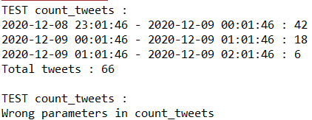
TEST count_tweets
print("TEST count_tweets :")
try:
(ranges, sum) = count_tweets(db, 1607464906, 1607475302, 3600, True, logger)
for i in range (0, ranges[:,0].size):
print(str(datetime.fromtimestamp(ranges[i][0])) + " - " + str(datetime.fromtimestamp(ranges[i][1])) + " : " + str(int(ranges[i][2])))
print("Total tweets : " + str(sum))
except:
print("Wrong parameters in count_tweets")
print("\nTEST count_tweets :")
try:
(ranges, sum) = count_tweets(db, 1607464906, 0, 3600, True, logger)
for i in range (0, ranges[:,0].size):
print(str(datetime.fromtimestamp(ranges[i][0])) + " - " + str(datetime.fromtimestamp(ranges[i][1])) + " : " + str(int(ranges[i][2])))
print("Total tweets : " + str(sum))
except:
print("Wrong parameters in count_tweets")

Slide 48
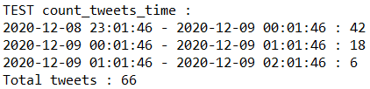
TEST count_tweets_time
print("\nTEST count_tweets_time :")
try:
(ranges, sum) = count_tweets_time(db, int2time(1607464906), int2time(1607475302), 3600, True, logger)
for i in range (0, ranges[:,0].size):
print(str(datetime.fromtimestamp(ranges[i][0])) + " - " + str(datetime.fromtimestamp(ranges[i][1])) + " : " + str(int(ranges[i][2])))
print("Total tweets : " + str(sum))
except:
print("Wrong parameters in count_tweets_time")

Slide 49
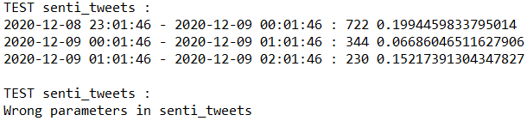
TEST senti_tweets
print("\nTEST senti_tweets :")
try:
ranges = senti_tweets(db, 1607464906, 1607475302, 3600, False, logger)
for i in range (0, ranges[:,0].size):
print(str(datetime.fromtimestamp(ranges[i][0])) + " - " + str(datetime.fromtimestamp(ranges[i][1])) + " : " + str(int(ranges[i][2])) + " " + str(ranges[i][3]))
except:
print("Wrong parameters in senti_tweets")
print("\nTEST senti_tweets :")
try:
ranges = senti_tweets(db, 1607464906, 0, 3600, False, logger)
for i in range (0, ranges[:,0].size):
print(str(datetime.fromtimestamp(ranges[i][0])) + " - " + str(datetime.fromtimestamp(ranges[i][1])) + " : " + str(int(ranges[i][2])) + " " + str(ranges[i][3]))
except:
print("Wrong parameters in senti_tweets")

Slide 50

TEST senti_tweets_time
print("\nTEST senti_tweets_time :")
try:
ranges = senti_tweets_time(db, int2time(1607464906), int2time(1607475302), 3600, False, logger)
for i in range (0, ranges[:,0].size):
print(str(datetime.fromtimestamp(ranges[i][0])) + " - " + str(datetime.fromtimestamp(ranges[i][1])) + " : " + str(int(ranges[i][2])) + " " + str(ranges[i][3]))
except:
print("Wrong parameters in senti_tweets_time")

Slide 51
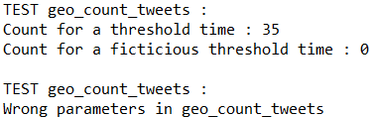
TEST geo_count_tweets
print("\nTEST geo_count_tweets :")
try:
count = geo_count_tweets(db, 1607466785, [(40.41388645, 18.1876629), (41.092715299999995, 16.87499235)], logger)
print("Count for a threshold time : " + str(count))
count = geo_count_tweets(db, 9999999999, [(40.41388645, 18.1876629), (41.092715299999995, 16.87499235)], logger)
print("Count for a ficticious threshold time : " + str(count))
except:
print("Wrong parameters in geo_count_tweets")
print("\nTEST geo_count_tweets :")
try:
count = geo_count_tweets(db, -1, [(40.41388645, 18.1876629), (41.092715299999995, 16.87499235)], logger)
print("Count for a ficticious threshold time : " + str(count))
except:
print("Wrong parameters in geo_count_tweets")

Slide 52

TEST geo_count_tweets_time
print("\nTEST geo_count_tweets_time :")
try:
count = geo_count_tweets_time(db, int2time(1607466785), [(40.41388645, 18.1876629), (41.092715299999995, 16.87499235)], logger)
print("Count for a threshold time : " + str(count))
count = geo_count_tweets_time(db, int2time(9999999999), [(40.41388645, 18.1876629), (41.092715299999995, 16.87499235)], logger)
print("Count for a ficticious threshold time : " + str(count))
except:
print("Wrong parameters in geo_count_tweets_time")

Slide 53
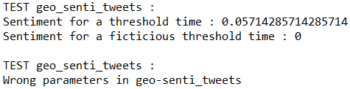
TEST geo_senti_tweets
print("\nTEST geo_senti_tweets : ")
try:
sentiment = geo_senti_tweets(db, 1607466785, [(40.41388645, 18.1876629), (41.092715299999995, 16.87499235)], logger)
print("Sentiment for a threshold time : " + str(sentiment))
sentiment = geo_senti_tweets(db, 9999999999, [(40.41388645, 18.1876629), (41.092715299999995, 16.87499235)], logger)
print("Sentiment for a ficticious threshold time : " + str(sentiment))
except:
print("Wrong parameters in geo-senti_tweets")
print("\nTEST geo_senti_tweets : ")
try:
geo_senti_tweets(db, -1, [(40.41388645, 18.1876629), (41.092715299999995, 16.87499235)], logger)
except:
print("Wrong parameters in geo-senti_tweets")

Slide 54

TEST geo_senti_tweets_time
print("\nTEST geo_senti_tweets_time : ")
try:
sentiment = geo_senti_tweets_time(db, int2time(1607466785), [(40.41388645, 18.1876629), (41.092715299999995, 16.87499235)], logger)
print("Sentiment for a threshold time : " + str(sentiment))
sentiment = geo_senti_tweets_time(db, int2time(9999999999), [(40.41388645, 18.1876629), (41.092715299999995, 16.87499235)], logger)
print("Sentiment for a ficticious threshold time : " + str(sentiment))
except:
print("Wrong parameters in geo-senti_tweets_time")

Slide 55
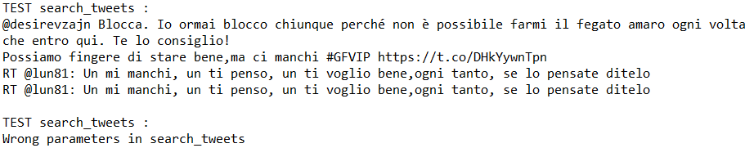
TEST search_tweets
print("\nTEST search_tweets :")
try:
tweetList = search_tweets(db, 1607464906, 1607475302, ["manchi", "fegato"], logger)
for x in tweetList:
print(x.text)
except:
print("Wrong parameters in search_tweets")
print("\nTEST search_tweets :")
try:
tweetList = search_tweets(db, -1, 1607475302, ["manchi", "fegato"], logger)
for x in tweetList:
print(x.text)

Slide 56
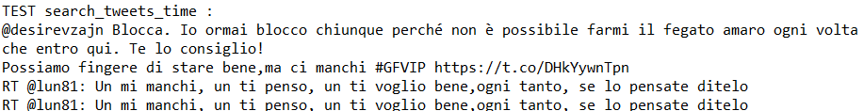
TEST search_tweets_time
print("\nTEST search_tweets_time :")
try:
tweetList = search_tweets_time(db, int2time(1607464906), int2time(1607475302), ["manchi", "fegato"], logger)
for x in tweetList:
print(x.text)
except:
print("Wrong parameters in search_tweets_time")

Slide 57
TEST search_geo_tweets
print("\nTEST search_geo_tweets :")
try:
tweetList = search_geo_tweets(db, ["Buonanotte", "#realjuve"], None, None, [(40.41388645, 18.1876629), (41.092715299999995, 16.87499235)], 1607466785, logger)
for x in tweetList:
print(x.text)
tweetList = search_geo_tweets(db, ["Buonanotte", "#realjuve"], 0, 1, [(40.41388645, 18.1876629), (41.092715299999995, 16.87499235)], 1607466785, logger)
for x in tweetList:
print(x.text)
except:
print("Wrong parameters in search_geo_tweets")
print("\nTEST search_geo_tweets :")
try:
tweetList = search_geo_tweets(db, ["Buonanotte", "#realjuve"], None, None, [(40.41388645, 18.1876629), (41.092715299999995, 16.87499235)], -1, logger)
except:
print("Wrong parameters in search_geo_tweets")

Slide 58
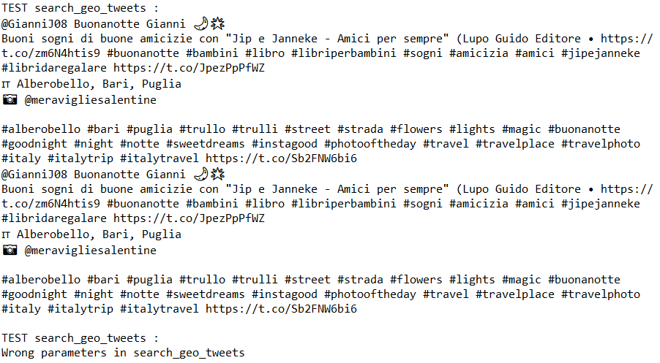
TEST search_geo_tweets

Slide 59
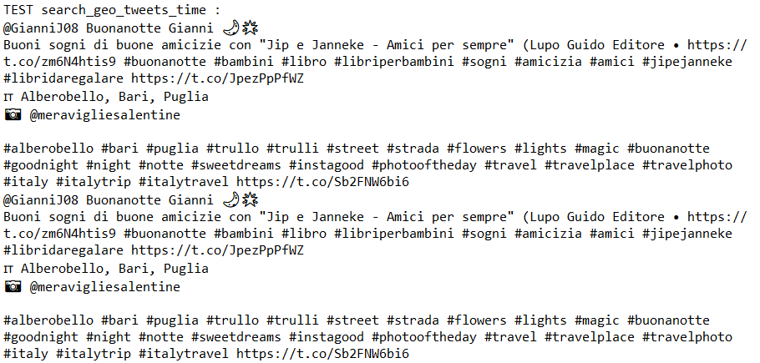
TEST search_geo_tweets_time
print("\nTEST search_geo_tweets_time :")
try:
tweetList = search_geo_tweets_time(db, ["Buonanotte", "#realjuve"], None, None, [(40.41388645, 18.1876629), (41.092715299999995, 16.87499235)], int2time(1607466785), logger)
for x in tweetList:
print(x.text)
tweetList = search_geo_tweets_time(db, ["Buonanotte", "#realjuve"], 0, 1, [(40.41388645, 18.1876629), (41.092715299999995, 16.87499235)], int2time(1607466785), logger)
for x in tweetList:
print(x.text)
except:
print("Wrong parameters in search_geo_tweets_time")

Slide 60
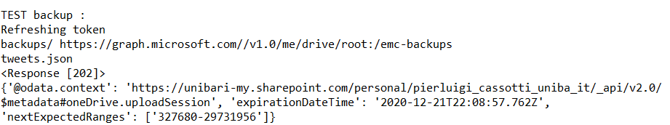
TEST backup
print("\nTEST backup :")
try:
backup(db, 1907466785, logger)
except:
print("Wrong parameters in backup")

Slide 61

TEST read_backups
#TEST read_backups
print("\nTEST read_backups : ")
try:
files = read_backups("1970", "01", "23", logger)
for file in files:
print(file[0])
except:
print("Wrong parameters in read_backups")

Slide 62
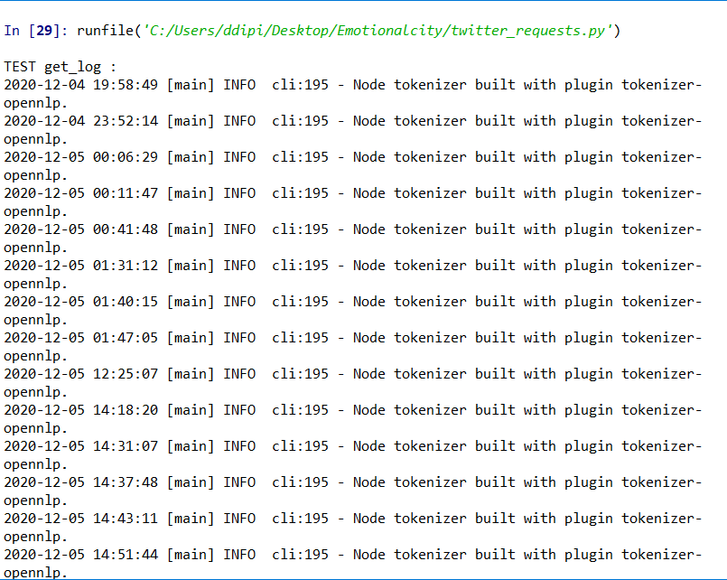
TEST get_log
print("\nTEST get_log : ")
try:
get_log("C:\\Users\ddipi\Desktop\emotionalcity\log.log", None, "INFO", "opennlp", logger)
print("\n")
get_log("C:\\Users\ddipi\Desktop\emotionalcity\log.log", string2int("2020/12/04 19:49:28"), "ERROR", None, logger)
except:
print("Wrong parameters in log")

Slide 63
TOOLS
ORACLE VM VIRTUAL BOX
MONGODB
CROWD PULSE
ANACONDA
DATA EXTRACTION
API IMPLEMENTATION
DATA STORING
CROWD PULSE EXECUTION

Slide 64


A Picture Is Worth a Thousand Words

Slide 65
THANKS
Do you have any questions?
d.dipierro7@studenti.uniba.com

